Slide 1
Software Engineering ELITE

Slide 2
Course objectives
On completion of the course, participants will be able to:
Describe software lifecycle
Differentiate between traditional and agile methodologies
Able to write user stories and acceptance criteria
To be able to translate acceptance criteria to test cases
To be aware of the process of configuration management, build and deployment

Slide 3
Why Agile?
Need for Agile Adoption
Improving Productivity
Enhanced Quality
Acceleration To Market
Managing Changing Priorities
Alignment between IT & Business goals
Improved Team Morale
Improvements Observed
Reduced S/W Defects
Reduced Cost
Accelerated Time –To- Market
Increased Productivity

Slide 4
Agile Vs Traditional –What is the Same?
Vision
Life Cycle
Requirements
Schedule
Team
Communication mechanisms

Slide 5
Traditional vs Iterative vs Agile
Requirement Analysis
Design
Coding
Testing
Deployment
R1 R1 R3
D1 D2 D3
C1 C2 C3
T1 T2 T3
Deployment
R1 D1 C1 T1 I1
R2 D2 C2 T2 I2
R3 D3 C3 T3 I3
R4 D4 C4 T4 I4
R5 D5 C5 T5 I5
Each phase divided into more parts(3);
Each phase being executed 3 times
Design starts only after 1st 3 iterations of req are over

Slide 6
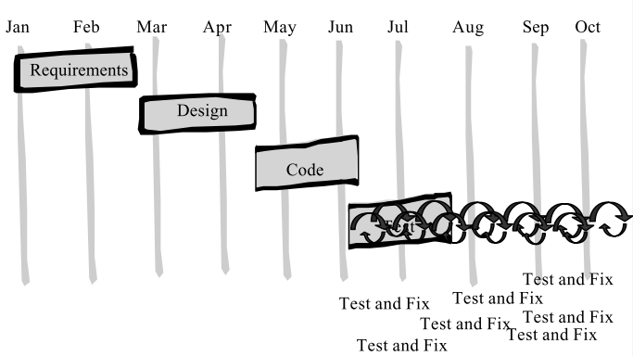
Waterfall model
Infrequent client communication
Delivery in Big Bang fashion!
High cost of Change.
Testing is done at the end and full justice to the job not done.

Slide 7
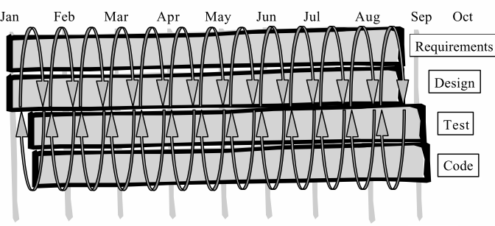
Agile Methodology
Agile has all phases in each iteration.
Continuous Client communication.
Delivery in short business focussed releases.
Develop in end to end functionality slices.
Low cost of change

Slide 8
Agile Vs Traditional
Fixed
Waterfall
Resources
Requirements
time
Agile
time
Resources
Features
Adjustments

Slide 9
Agile Vs Traditional
Traditional
Big bang delivery
Manage Teams
Agile
Goals
Manage Principles
Self organized and managed teams
Manage Tasks
Baseline release plan
Flexible release plan
Planning by features
Planning by tasks
Learn at the end
Learn at every iteration

Slide 10
Agile Elements

Slide 11
Agile Elements
Practices (Methods)
Principles
Values
Available at http://agilemanifesto.org/

Slide 12
Agile manifesto: Core values
Core value1: Individuals and interactions over processes and tools (People Centric)
Core value 2: Working software over comprehensive documentation (Quality Delivery)
Less documentation of process with good interactions among the stake holders
Spend less time and do bear min. documentation
Monitoring only happens through working software
Available at http://agilemanifesto.org/

Slide 13
Agile manifesto: Core values
Core value 3: Customer collaboration over contract negotiation (Involvement)
Core value 4: Respond to change over following a plan (Adaptation)
Customer is part of development process; it is collaboration in decision meeting, speed of communication and individual's connect
Rather than focusing on outdated plan, deal with changing realities
Short duration contracts; establish trust;
Given the requirement, negotiate money but collaborate
Ex: Monster gives an order to your company; Goal is to get more job seekers to the site and contractual agreements can be flexible enough
This is progressive elaboration; The agile framework itself put check points –in traditional approach change is chasing us where as changes are expected in agile
Available at http://agilemanifesto.org/

Slide 14
Agile Principles: Behind Agile manifesto
5. Build projects around motivated individuals; Give them environment and support they need and trust them to get the job done: Treat them as volunteers and not as subordinates
3. Deliver working software frequently from a couple of weeks to couple of months with preference to the timescale
1. Customer satisfaction through early and continuous delivery of valuable software
2. Welcoming change requirements –even late in the development; To harness change for customer’s competitive advantage
4. Business people and developers must work together daily through out the project
6. Most efficient and effective method of conveying information to and within a development team is face –to –face conversation
Available at http://agilemanifesto.org/
Notes:
As Scrum Master:
Expose progress and impact in terms of time lines
Create sustainable environment and maintain constant pace
By way of allocating and committing we should have reflection shown on velocity
Continuously focus on technical excellence to maintain intrinsic quality [time, scope, schedule]

Slide 15
12 Principles…
12. At regular intervals teams reflects on how to become more effective, then tunes and adjusts its behavior accordingly
10. Simplicity: Art of maximizing the extent of work not done –is essential
7. Working software is the primary measure of progress
8. Agile processes promote sustainable development. Sponsors, developers and users should be able to maintain a constant pace indefinitely –It brings transparency
11. The best architectures, requirements and designs emerge from self organizing teams
9. Continuous attention to technical excellence and good design enhances agility (design –refactor code –design cycle)
Available at http://agilemanifesto.org/
Notes:
Simplicity: Art of maximizing the amount of work not done by delivering high business value to the customer through minimal work!
Find minimal set of features

Slide 16
Introduction to Scrum

Slide 17
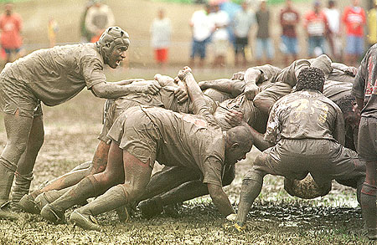
Scrum

Slide 18
Scrum in 100 words
Scrum is an agile process that allows us to focus on delivering the highest business value in the shortest time.
It allows us to rapidly and repeatedly inspect actual working software (every two weeks to one month).
The business sets the priorities. Our teams self-manage to determine the best way to deliver the highest priority features.
Every two weeks to a month anyone can see real working software and decide to release it as is or continue to enhance for another iteration.

Slide 19
History of Scrum
1995: analysis of common software development processes → not suitable for empirical, unpredictable and non-repeatable processes
Design of a new method: Scrum by Jeff Sutherland & Ken Schwaber
Enhancement of Scrum by Mike Beedle & combination of Scrum with Extreme Programming
1996: introduction of Scrum at OOPSLA conference
2001:
publication “Agile Software Development with Scrum” by
Ken Schwaber & Mike Beedle
Successful appliance of Scrum in over 50 companies
Founders are members in the Agile Alliance

Slide 20
Scrum…..
Scrum is an agile process for developing software.
Scrum is an iterative, incremental framework.
With Scrum, projects progress via a series of iterations (sprints)
Sprints or Iterations are typically 1-4 weeks in length.
The Sprints are of fixed duration – they end on a specific date
whether the work has been completed or not, and are never extended.
At the end of the Sprint, the team demonstrates what they have accomplished.
* Sprints are fixed duration work cycles.

Slide 21
Scrum
Empirical Process:
We don’t know upfront the exact input combination
Scrum is useful for empirical processes where inputs, process not defined and the output is vision
We have to use other three controls for Empirical Process –namely Focus on transparency; Inspection and Adoption
Transparency:
Adoption: What you miss in the pilot –fix it in the next pilot
Ex. Making a recipe: Here we don’t have previous measurement
When do you use Scrum?
When it is new product development
Process is Empirical
Right use case for Scrum is Empirical Process; Anything as recipe creation can be mapped to Scrum
When you can avoid Scrum?
Scrum CANNOT be used for dynamic applications because for scrum you need a stable environment , time for inspection and adoption
For fixed bid projects might not be the right option

Slide 22
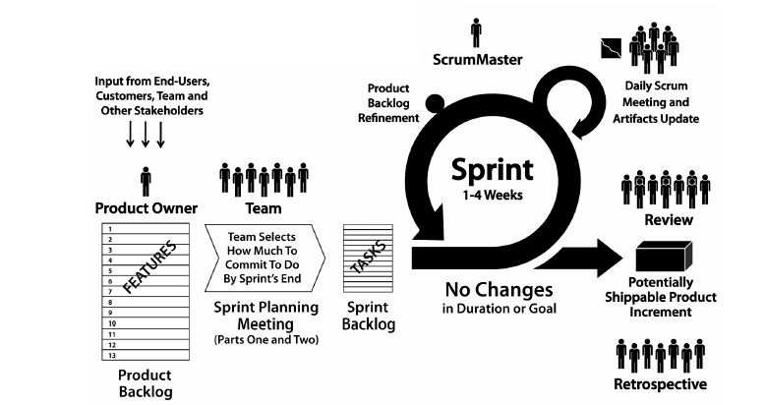
Agile Scrum Process Diagram
Scrum: Process Overview

Slide 23
Elements of Agile
Roles
Story points and Estimation
Product Backlog
Sprint Backlog
Deliverables of Sprint
Burn Down Chart

Slide 24
Scrum Roles …
Product Owner
Creates initial product vision –Overall requirements
Decides on release date and content
Responsible for profitability –ROI
Prioritize features according to market value
Interact with stake holders and customers to define PB
Responsible for grooming PB
Accept or reject work outcomes/deliverables
Scrum Master
Represents Management to the project
Responsible for value system
Removes impediments
Ensures team is fully functional and Productive
Enables close cooperation across all roles and functions
Shields the team from external interferences

Slide 25
Scrum Roles …
Team
Size 7 + 2 people
Cross functional
Full time dedicated
Self organizing
Responsible for quality
Estimates complexity
Committed to develop functionality

Slide 26



Scrum Roles and responsibilities…
Item | Developer | PO | Scrum Master
Estimation
Backlog prioritization
Agile coaching
Velocity prediction
Definition of Done
Process Adherence
Tech Decisions
Sprint planning
$$√$$
$$√$$
$$√$$

Slide 27
Scrum Ceremonies

Slide 28
Scrum
Scrum has 4 ceremonies, 3 roles and three artifacts
PMBOK is collection of 44 processes
There are two types of processes
Defined process [We don’t need Scrum for defined processes]
Empirical process [Scrum can be used]
Defined Process:
Input parameters are defined, steps in execution are known, and output is predictable
Ex. McDonald pizza delivery: It will be declared that with in 45 -75 sec, pizza will be delivered; In general it is expected with in 60 sec it will be delivered
<40 sec, >70 sec means the process is out of control and use controls like corrective and preventive actions are recommended

Slide 29
Scrum ceremonies
Sprint Planning
It has two segments each 4 hr duration; Part 1 and Part 2
Input is product backlog (It is an ordered list of desired functionalities)
Segtment2: Sprint backlog is artifact along with estimate on no of hrs (~200 hrs/week for 5 member team)
PO presents the set of features; teams ask questions to understand requirements.
Team itself will decides what it can deliver in the sprint based on the size of stories, current capabilities of the teams, its definition of done; holidays and leaves –if any
PO must be present to lead the team in right direction and to answer questions from the development team
SM must ensure that any other stakeholder needed to help the team to understand the requirements is present.
New backlog items if any for inclusion will be sized immediately during this meeting
Outcome of this meeting is selected product backlog along with definition of DONE (Features running and tested)
Part 1 (requirement workshop –to identify items for the sprint)
Picking up the items identified from Product backlog and visualize into engineering tasks like WBS, Features, slicing them etc.
In Segment 2 –activity estimation will be done

Slide 30
Scrum ceremonies
Sprint Retrospective
Sprint retrospective is focussed on process –the way team is working together, including their technical skills, software tools, practices and the way they are working.
Daily Stand up meeting
It is final meeting of the sprint. Unlike sprint review meeting, the retro meeting is only to scrum team –PO, Scrum master, team members.
Daily scrum (stand up) meeting during the sprint -15 min., every meeting is strictly time bounded
Not for reporting the progress to scrum master or product owner
Scrum master makes sure the team members signed up for some work for next 24 hrs to deliver next item in the backlog
Chickens: Involved but not committed; Allowed to make comment one at a time
Pigs: Only participants allowed to speak –these are committed to the project
Two perspectives of daily scrum
To provide coordination mechanism for everyone in the project and hear where everyone else is
Each team member to make commitments
Sprint Review Meeting
Sprint review meeting focussed on the product.
To introspect what team has delivered and gather feedback from the attendees to adopt the plan for the succeeding sprint.
Sprint review meeting is open for all stake holders.
In this meeting goal for the next sprint is set.

Slide 31
Scrum -Ceremonies ..
Daily Stand up meeting:
To ensure how well we are following the plan; Helps teams in monitoring, strengthens collaboration, and how well they are progressing the sprint.
Goal of daily standup meeting is to generate collaborative environment and address peer –pressure
Scrum master ensures the daily stand up meeting happens regularly
Note:
Three question to be asked in the daily stand up meeting:
What we did yesterday?
Are there any impediments?
Product Owner grooming the product backlog every day
Sprint Backlog we should not change it during the sprint. However it might be difficult to visualize all the engineering tasks
What we do today?

Slide 32
Characteristics of a Sprint
Sprint
A Sprint is a time boxed iteration cycle with in which team works with a list of features
At the end of the sprint it is expected to have a shippable product
With Scrum, projects progress via a series of iterations (sprints)
Sprints or Iterations are typically 1-4 weeks in length.
The Sprints are of fixed duration – they end on a specific date ( whether the work has been completed or not, and are never extended).
At the end of the Sprint, the team demonstrates what they have accomplished.
Sprint should follow INVEST Model
Independent
Negotiable
Valuable
Estimateable
Small in Size
Testable

Slide 33
Product backlog, Prioritization and User Stories

Slide 34
Product Backlog: Prioritization
High Priority
Priority =Urgency x Business Value
Stakeholders see for voting
User Story1
User Story2
User Story3
User Story3
User Story3
User Story3
User Story3
User Story3
…..
Epic
Theme
5 | 5 | 10 | 15 | 20 | 25
4 | 4 | 8 | 12 | 16 | 20
3 | 3 | 6 | 9 | 12 | 15
2 | 2 | 4 | 6 | 8 | 10
1 | 1 | 2 | 3 | 4 | 5
 | 1 | 2 | 3 | 4 | 5
Business Value
Low Priority
Urgency →
5: Extremely urgent

Slide 35
User stories

Slide 36
User Story: Mike Cohn’s Template ….
As a [type of user]
I want to [perform some task]
so that I can [reach some goal]

Slide 37
User Story1
As a customer,
I want to know how much my order will cost to ship based on the shipping speed I choose
so that I can choose a different shipping speed if I want to.

Slide 38
User Story 2
As a shopper on our site,
I want to delete items out of my cart
so that I don’t purchase extra items that I decide I don’t want

Slide 39
User Story –Participation of team
Product Owner: We just want some easy way for users to delete items;
but we don’t have a specific implementation in mind
Tester: Should they be able to delete several items at once?
Product Owner: Yes , Just make it as easy as possible
Tester: What if they accidentally delete an item they wanted to buy?
Product Owner: Is there some way for retrieval of deleted items?
Developer: Sure, But you should write a new story for that.
For now, we should start with basic functionality
Tester: What is the worst thing that could happen with this story?
Product Owner: If they cant figure out how to delete,
they might just abandon their whole shopping basket.
It has to be easy and really obvious
Scrum Master:
Calls for an estimate. Team understands that they are sizing only the basic story point
for deleting items; not doing something about deleted items

Slide 40
Epics, themes, user stories
Epic: Large user story
Manage oil-well data based on geospatial location
Theme: Set of related user stories
Handle oil production data per well
Story: Business feature
Store production data for well

Slide 41
User story and acceptance criteria
<User Story ID>
As an end user I want to be able to cancel a reservation so that I can I get refund when I am not travelling
Priority: 2
Estimate: 8
Confirmation/Acceptance criteria:
A user who cancels more than 24 hrs prior to departure gets complete refund
A user who cancels <24 hrs prior to departure gets 75%
Translated code is displayed on the site and is emailed to user

Slide 42
3 C’s a User Story
1st C: A Card (or often a Post-It note), a physical token giving tangible and durable form to what would otherwise only be an abstraction
2ndC: A conversation taking place at different time and places during a project between the various people concerned by a given feature of a software product: customers, users, developers, testers;
3rd C: The confirmation, finally, the more formal the better, that the objectives the conversation revolved around have been reached. –
See more at: http://guide.agilealliance.org

Slide 43
Splitting User Stories
Split the story –removing cross cutting concerns
One with and one with out cross cutting concerns -Like field validations,
security, logging, error handling …
Consider Splitting a story –by separating functional and non functional aspects into separate stories
Disaggregation
Splitting the story into set of engineering tasks and compare relatively
Consider Splitting a story into smaller ones if they have different priorities
“As a user I am required to log in to the system”
Acceptance:
Valid username and pwd; Invalid pwd 3 times in a row means access denied
In case of access denial an email is sent indicating un-authorised access by some one.
In this case, customer might be willing to release the product with out retry time –out option and email option.
Don’t split story into tasks –Don’t split a large story into tasks instead, deliver a partial UI, middle tier, and DB as a cohesive subset of all layers

Slide 44
Thank you Prakash.LNS@TechMahindra.com

